Slide 1
Linear Constant Coefficient ODEs
1. First order ODEs (revision)
Minimal thing that one must know
Assignment at the last slides. Submit on Monday

Slide 2
It is possible to split up the solution of the problem into two parts, the zero input solution, and the zero state solution. The zero input solution is the response of the system to the initial conditions, with the input set to zero. The zero state solution is the response of the system to the input, with initial conditions set to zero. The complete response is simply the sum of the zero input and zero state response.
The question naturally arises: why split a single problem into two separate problems? There are several reasons: the two problems are each easier to solve; the effects of the initial conditions are separated from those due to the inputs; if the solution is to be solved with several different initial conditions (or inputs), only part of the problem needs to be solved again.

Slide 3
Zero input solution

Slide 5
Impulse : our first input function
Refer earlier given slides for derivation
Linear Constant Coefficient ODEs
Impulse response.
At least byheart the impulse effect

Slide 6
Why Impulse Response is Important
Any Input function to a system can be represented (and visualized ) as a series of impulses. If we know impulse response of a Linear system ( that is impulse response to corresponding ODE) we can obtain , system response to any input function by convolving input function with impulse response.
We will elaborate later (in the next set of slides) with several Examples

Slide 7
Impulse response

Slide 8
First Effect of Impulse to systems defined by First order ODE
The system variable get a nonzero initial value.
That is, if y(t) is system variable then
y(0₊)= a non_zero value

Slide 11
2. Second order linear constant coefficient
ODEs (revision)

Slide 12
Second Order
Zero input solution

Slide 14
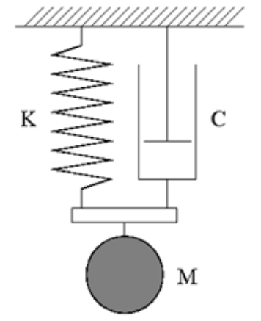
Impulse response
Physical Interpretation:
If impulse is given to the mass in the figure
the first thing to happen is that the energy of impulse is transferred as Kinetic energy of Mass and Mass gets an initial velocity.

Slide 15
In second order system, the
effect of impulse appears
as a nonzero value to y’(0₊)

Slide 17
Challenge
How will you solve
Assignment to be submitted on Monday 9/1/23

